Slide 1
MAGNETOSTATIC

Slide 2
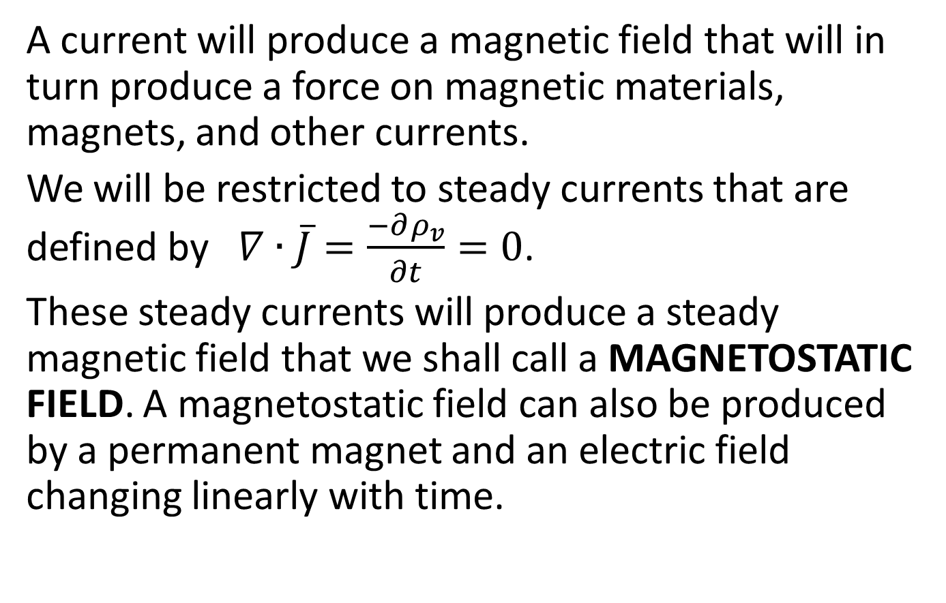
MAGNETOSTATIC FIELD INTENSITY FROM THE BIOT-SAVART LAW
A current will produce a magnetic field that will in turn produce a force on magnetic materials, magnets, and other currents.
We will be restricted to steady currents that are defined by $∇∙\overline{J}=\frac{−∂ρ_{v}}{∂t}=0$.
These steady currents will produce a steady magnetic field that we shall call a MAGNETOSTATIC FIELD. A magnetostatic field can also be produced by a permanent magnet and an electric field changing linearly with time.

Slide 3
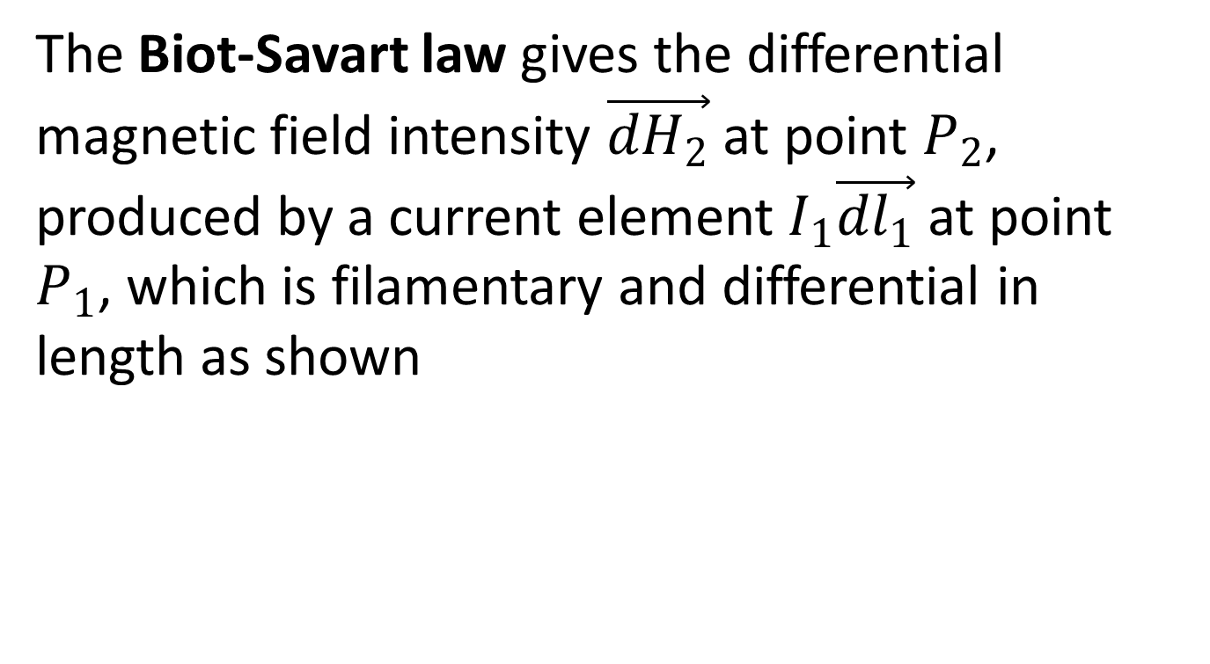
The Biot-Savart law gives the differential magnetic field intensity $\vec{{dH}_{2}}$ at point $P_{2}$, produced by a current element $I_{1}\vec{{dl}_{1}}$ at point $P_{1}$, which is filamentary and differential in length as shown

Slide 4
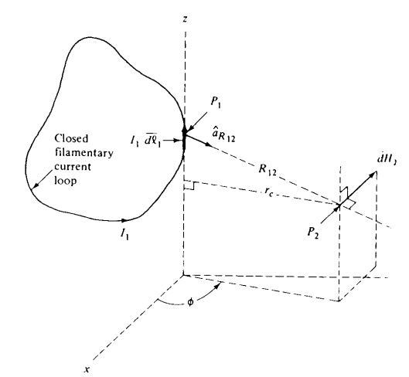

Slide 5
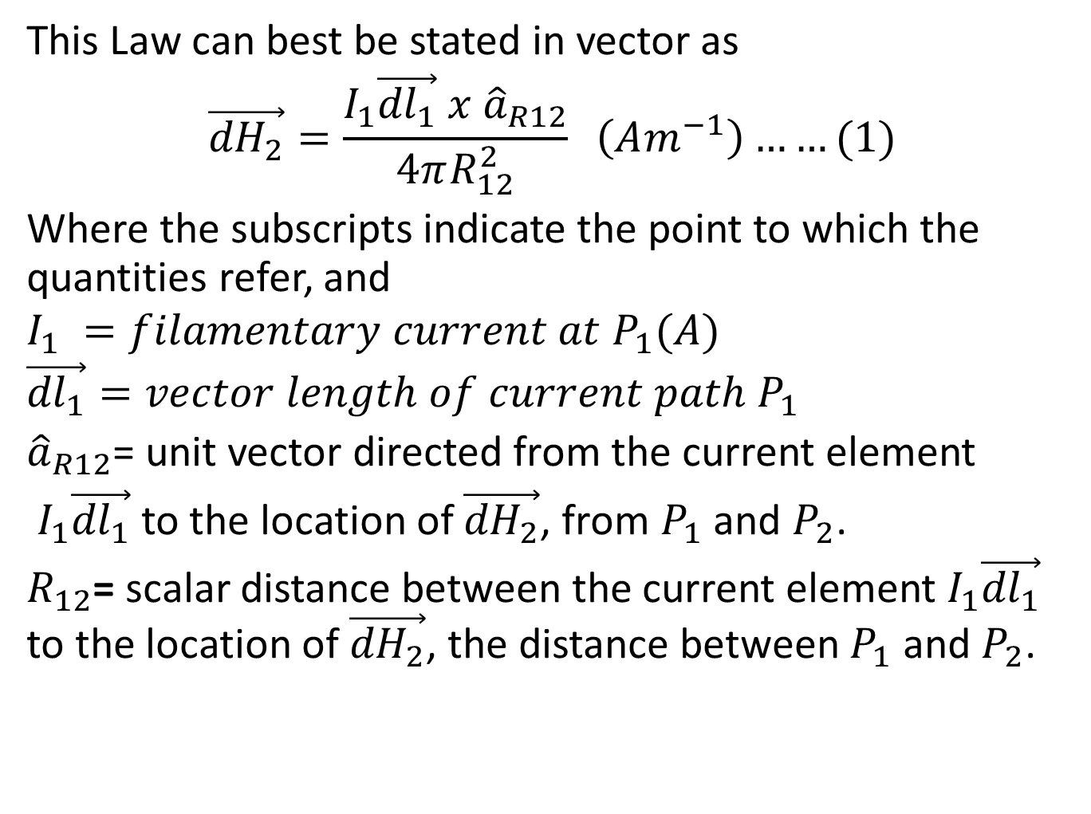
This Law can best be stated in vector as
$$\vec{{dH}_{2}}=\frac{I_{1}\vec{{dl}_{1}} x {\hat{a}}_{R12}}{4πR_{12}^{2}} \left(Am^{−1}\right)……(1)$$
Where the subscripts indicate the point to which the quantities refer, and
$$I_{1} =filamentary current at P_{1}(A)$$
$$\vec{{dl}_{1}}=vector length of current path P_{1}$$
${\hat{a}}_{R12}$= unit vector directed from the current element
$I_{1}\vec{{dl}_{1}}$ to the location of $\vec{{dH}_{2}}$, from $P_{1}$ and $P_{2}$.
$R_{12}$= scalar distance between the current element $I_{1}\vec{{dl}_{1}}$ to the location of $\vec{{dH}_{2}}$, the distance between $P_{1}$ and $P_{2}$.

Slide 6
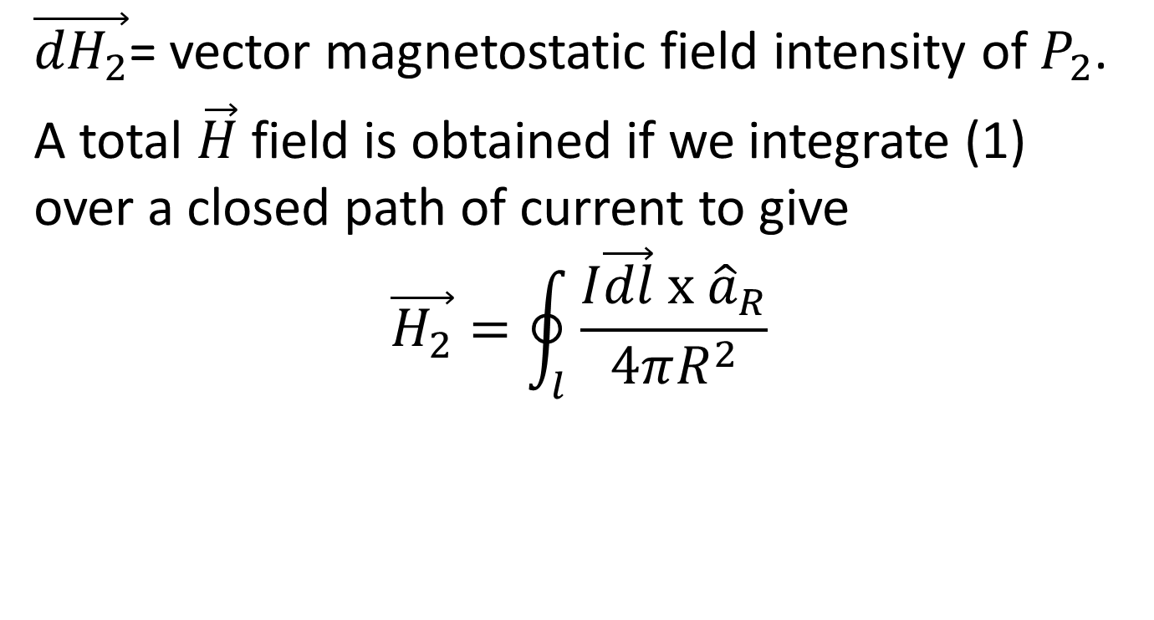
$\vec{{dH}_{2}}$= vector magnetostatic field intensity of $P_{2}$.
A total $\vec{H}$ field is obtained if we integrate (1) over a closed path of current to give
$$\vec{H_{2}}=\oint_{l}{\frac{I\vec{dl} x {\hat{a}}_{R}}{4πR^{2}}}$$

Slide 7
AMPERE’S CIRCUITAL LAW
In our study of electrostatics, we had Gauss’s law to simplify our solutions in cases of symmetrical charge distribution. In magnetostatics , a parallel law exists in the form of Ampere’s circuital law. We will be able to solve formidable magnetostatic problems in cases of symmetrical current distributions

Slide 8
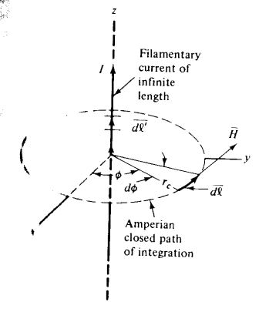

Slide 9
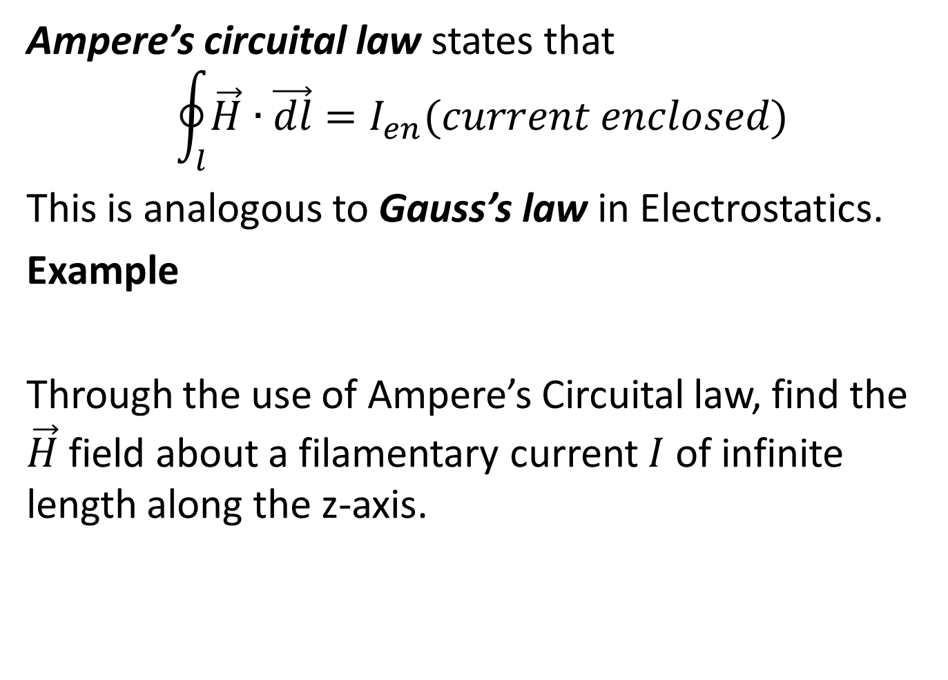
Ampere’s circuital law states that
$$\oint_{l}{\vec{H}}∙\vec{dl}=I_{en}(current enclosed)$$
This is analogous to Gauss’s law in Electrostatics.
Example
Through the use of Ampere’s Circuital law, find the $\vec{H}$ field about a filamentary current $I$ of infinite length along the z-axis.

Slide 10
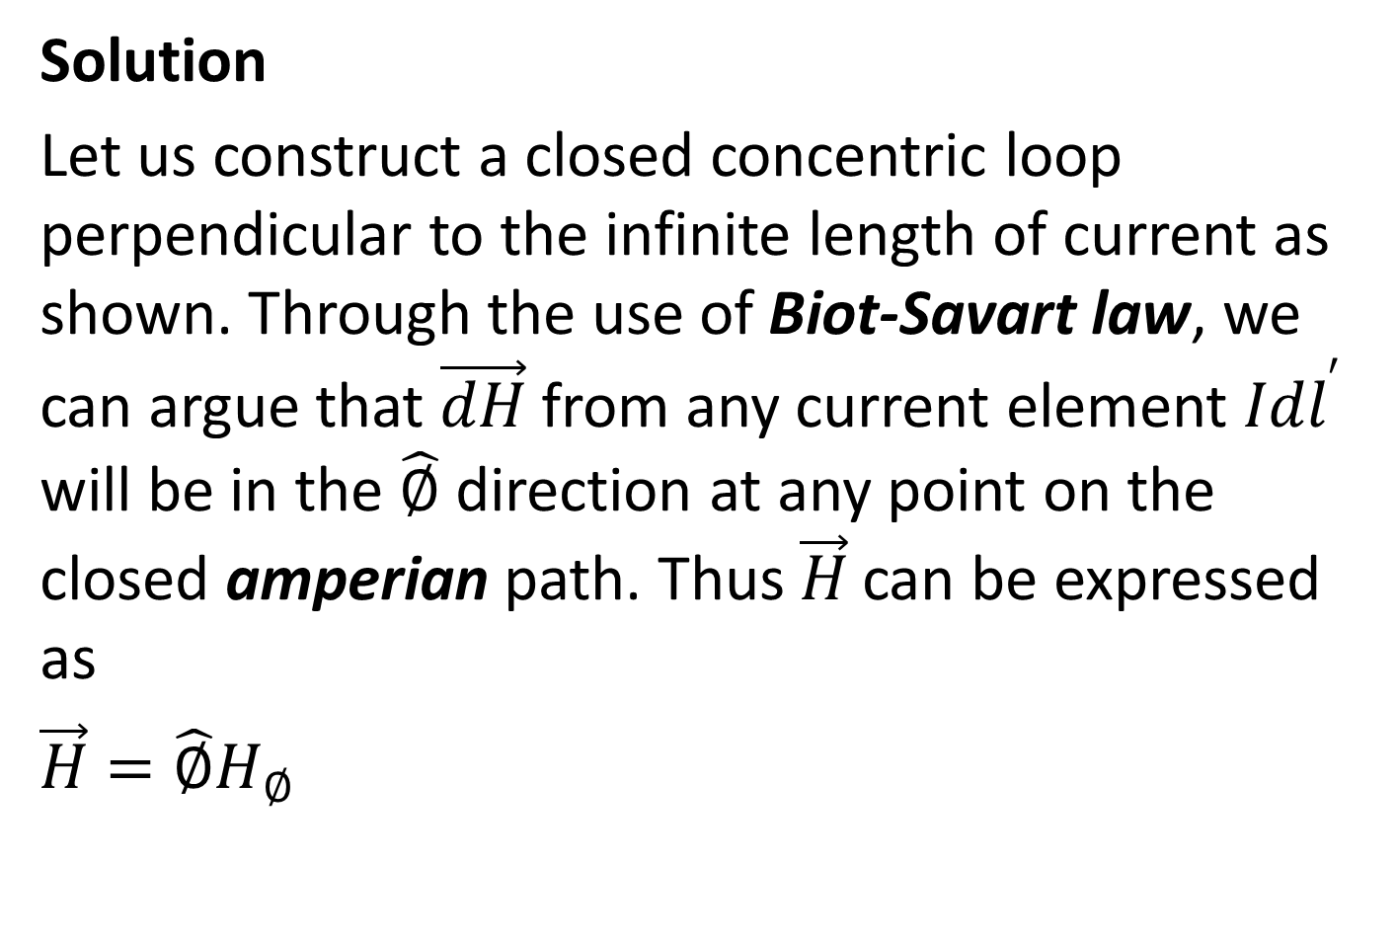
Solution
Let us construct a closed concentric loop perpendicular to the infinite length of current as shown. Through the use of Biot-Savart law, we can argue that $\vec{dH}$ from any current element $I{dl}^{′}$ will be in the $\hat{∅}$ direction at any point on the closed amperian path. Thus $\vec{H}$ can be expressed as
$\vec{H}=\hat{∅}H_{∅}$

Slide 11
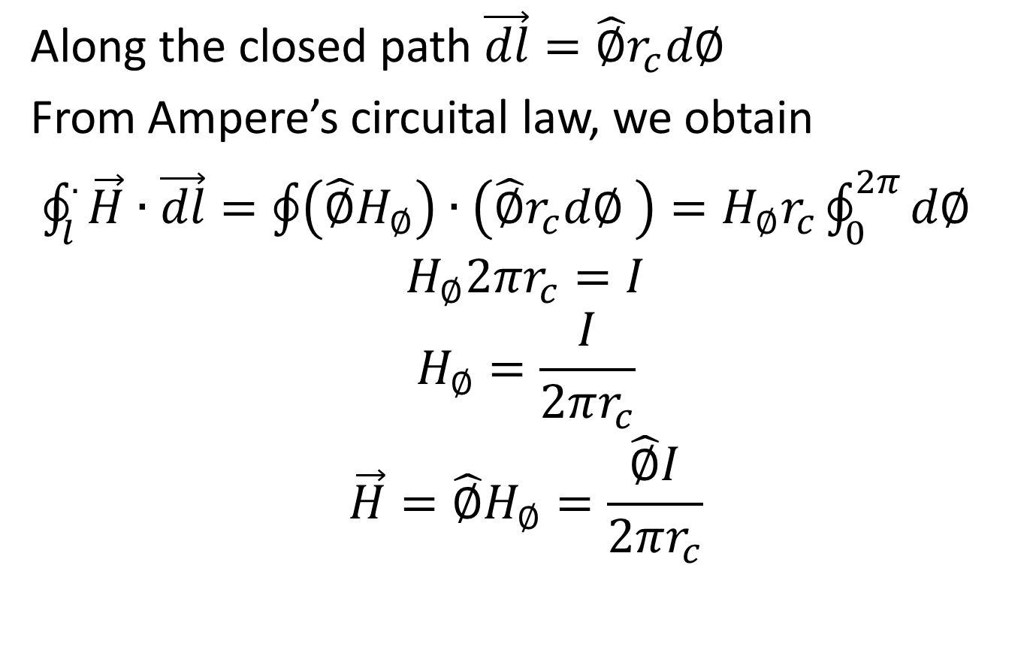
Along the closed path $\vec{dl}=\hat{∅}r_{c}d∅$
From Ampere’s circuital law, we obtain
$\oint_{l}^{.}{\vec{H}}∙\vec{dl}=\oint{\left(\hat{∅}H_{∅}\right)}∙\left(\hat{∅}r_{c}d∅ \right)=H_{∅}r_{c}\oint_{0}^{2π}{d∅}$
$$H_{∅}2πr_{c}=I$$
$$H_{∅}=\frac{I}{2πr_{c}}$$
$$\vec{H}=\hat{∅}H_{∅}=\frac{\hat{∅}I}{2πr_{c}}$$

Slide 12
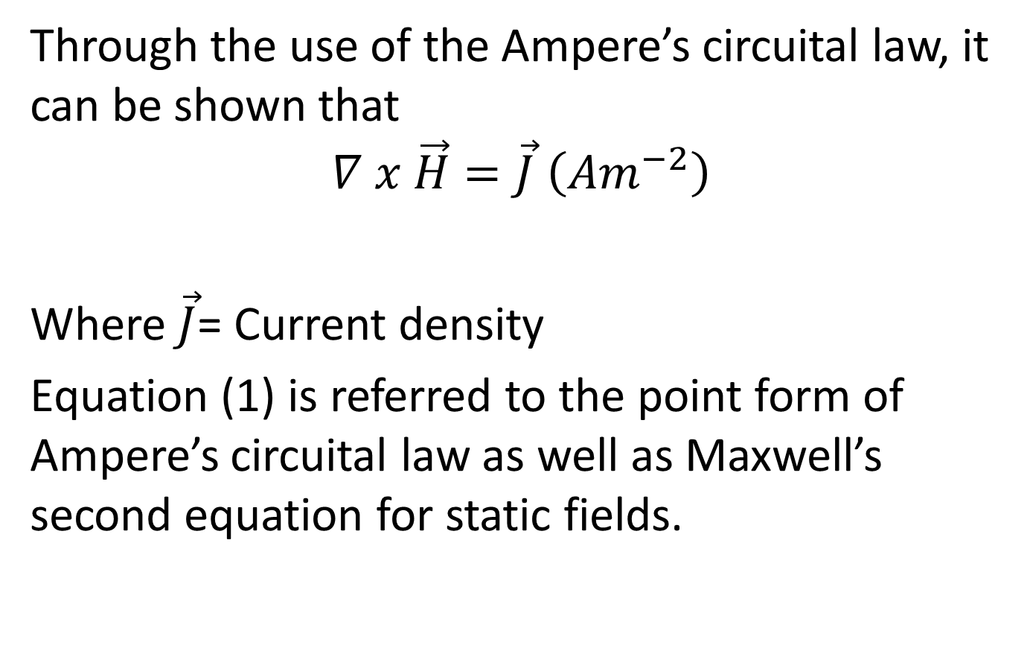
CURL
Through the use of the Ampere’s circuital law, it can be shown that
$$∇ x \vec{H}=\vec{J} \left(Am^{−2}\right)$$
Where $\vec{J}$= Current density
Equation (1) is referred to the point form of Ampere’s circuital law as well as Maxwell’s second equation for static fields.

Slide 13
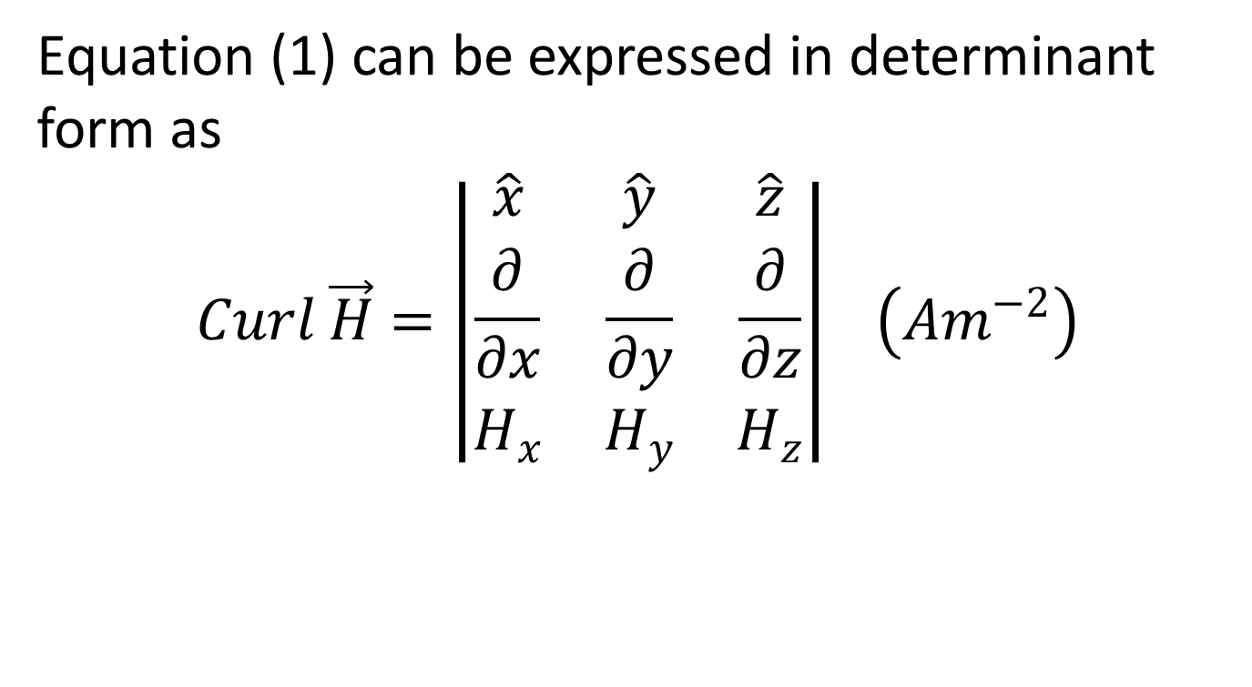
Equation (1) can be expressed in determinant form as
$$Curl \vec{H}=\left|\begin{matrix}\hat{x} & \hat{y} & \hat{z} \\ \frac{∂}{∂x} & \frac{∂}{∂y} & \frac{∂}{∂z} \\ H_{x} & H_{y} & H_{z}\end{matrix}\right| \left(Am^{−2}\right)$$

Slide 14
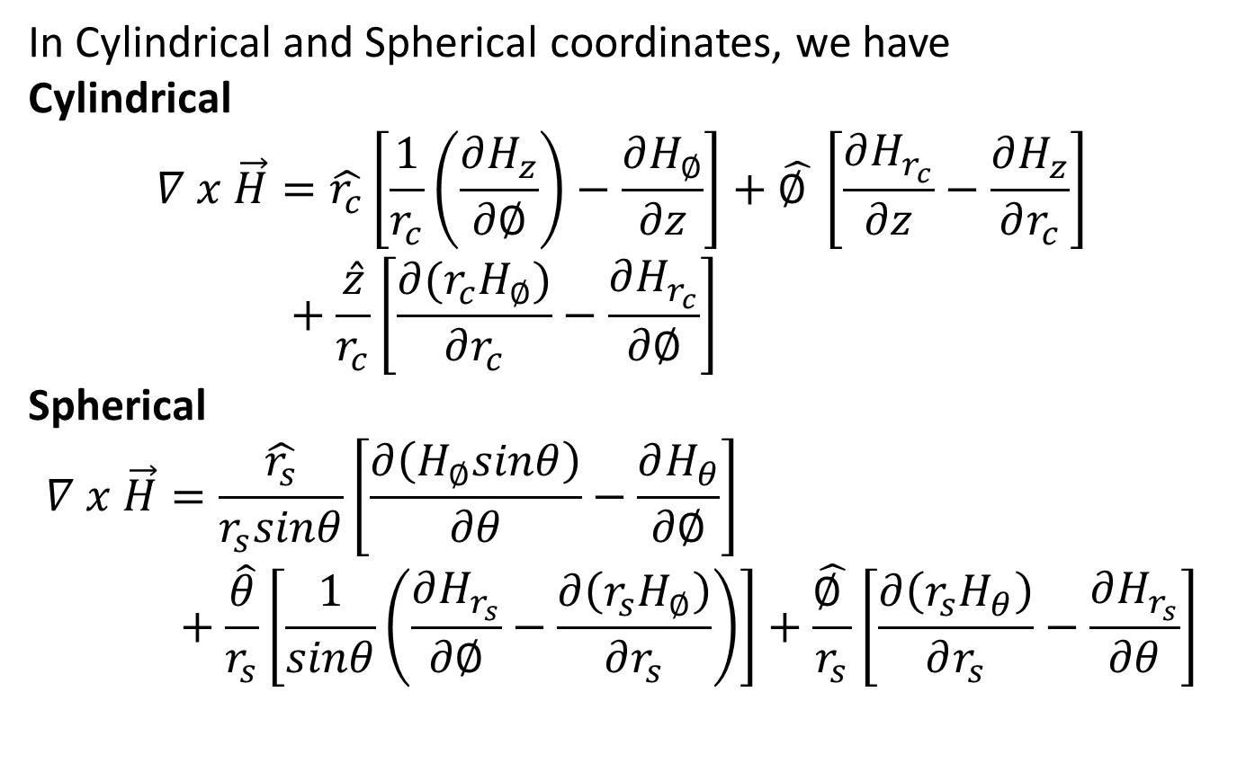
In Cylindrical and Spherical coordinates, we have
Cylindrical
$$∇ x \vec{H}=\hat{r_{c}}\left[\frac{1}{r_{c}}\left(\frac{∂H_{z}}{∂∅}\right)−\frac{∂H_{∅}}{∂z}\right]+\hat{∅ }\left[\frac{∂H_{r_{c}}}{∂z}−\frac{∂H_{z}}{∂r_{c}}\right]+\frac{\hat{z}}{r_{c}}\left[\frac{∂(r_{c}H_{∅})}{∂r_{c}}−\frac{∂H_{r_{c}}}{∂∅}\right]$$
Spherical
$$∇ x \vec{H}=\frac{\hat{r_{s}}}{r_{s}sinθ}\left[\frac{∂\left(H_{∅}sinθ\right)}{∂θ}−\frac{∂H_{θ}}{∂∅}\right]+\frac{\hat{θ}}{r_{s}}\left[\frac{1}{sinθ}\left(\frac{∂H_{r_{s}}}{∂∅}−\frac{∂\left(r_{s}H_{∅}\right)}{∂r_{s}}\right)\right]+\frac{\hat{∅ }}{r_{s}}\left[\frac{∂\left(r_{s}H_{θ}\right)}{∂r_{s}}−\frac{∂H_{r_{s}}}{∂θ}\right]$$

Slide 15
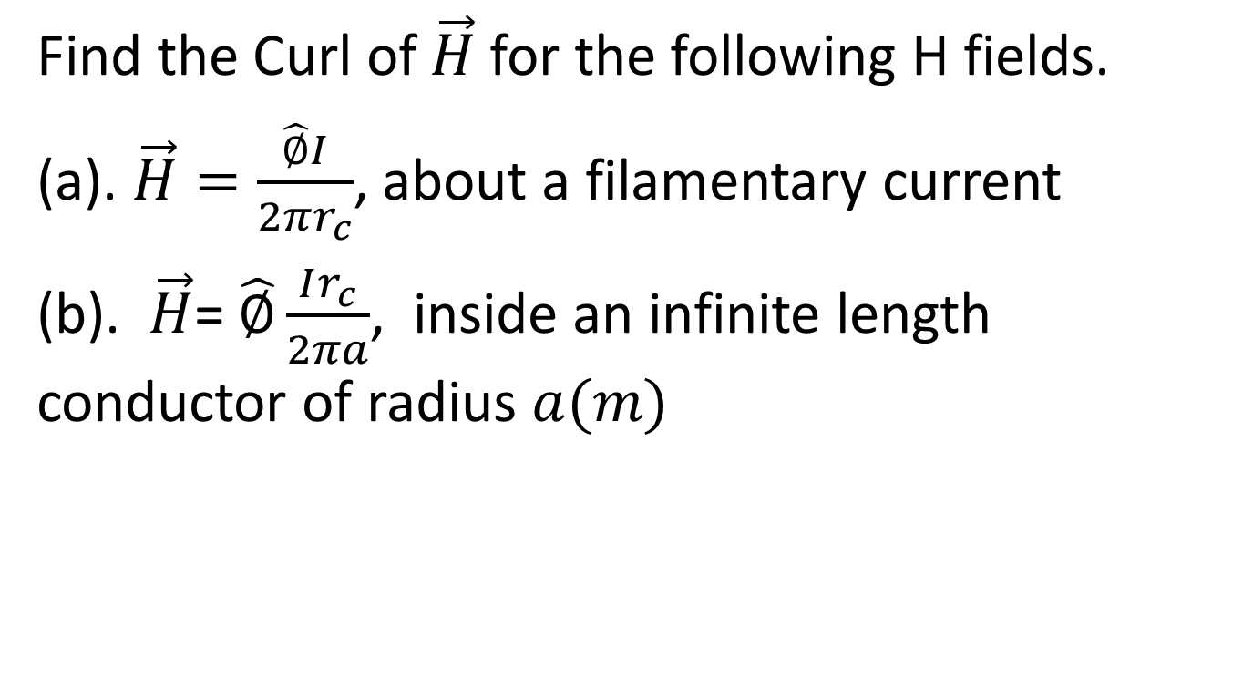
TRY
Find the Curl of $\vec{H}$ for the following H fields.
(a). $\vec{H}=\frac{\hat{∅}I}{2πr_{c}}$, about a filamentary current
(b). $\vec{H}$= $\hat{∅}\frac{Ir_{c}}{2πa}$, inside an infinite length conductor of radius $a(m)$

Slide 16
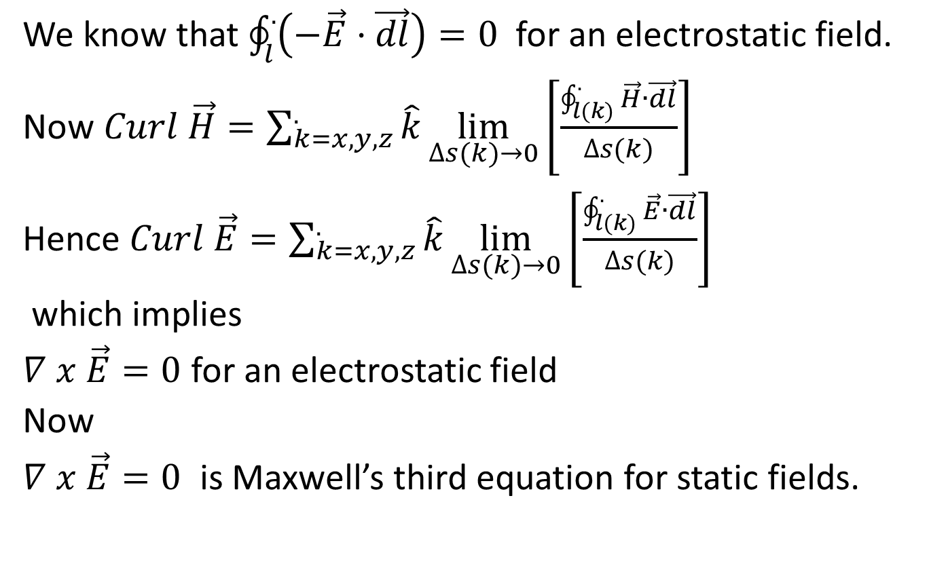
We know that $\oint_{l}^{.}{\left(−\vec{E}·\vec{dl}\right)=0}$ for an electrostatic field.
Now $Curl \vec{H}=\sum_{k=x,y,z}^{.}{\hat{k}\lim_{∆s(k)→0}\left[\frac{\oint_{l(k)}^{.}{\vec{H}}∙\vec{dl}}{∆s(k)}\right]}$
Hence $Curl \vec{E}=\sum_{k=x,y,z}^{.}{\hat{k}\lim_{∆s(k)→0}\left[\frac{\oint_{l(k)}^{.}{\vec{E}}∙\vec{dl}}{∆s(k)}\right]}$
which implies
$∇ x \vec{E}=0$ for an electrostatic field
Now
$∇ x \vec{E}=0$ is Maxwell’s third equation for static fields.

Slide 17
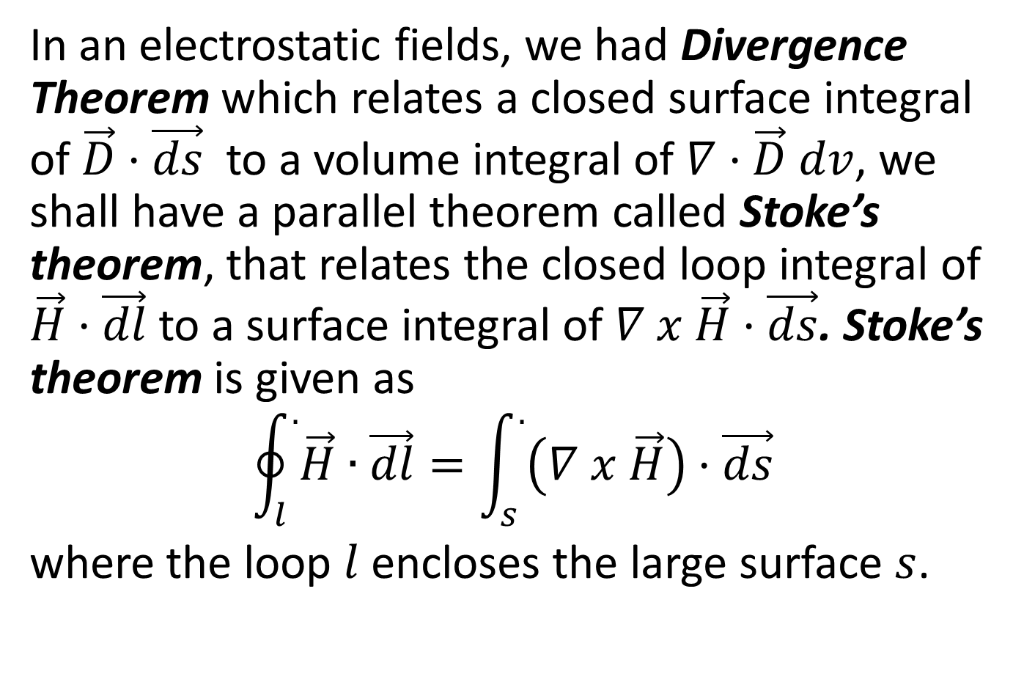
STOKE’S THEOREM
In an electrostatic fields, we had Divergence Theorem which relates a closed surface integral of $\vec{D}·\vec{ds}$ to a volume integral of $∇·\vec{D} dv$, we shall have a parallel theorem called Stoke’s theorem, that relates the closed loop integral of $\vec{H}·\vec{dl}$ to a surface integral of $∇ x \vec{H}·\vec{ds}$. Stoke’s theorem is given as
$$\oint_{l}^{.}{\vec{H}}∙\vec{dl}=\int_{s}^{.}{\left(∇ x \vec{H}\right)·\vec{ds}}$$
where the loop $l$ encloses the large surface $s$.

Slide 18
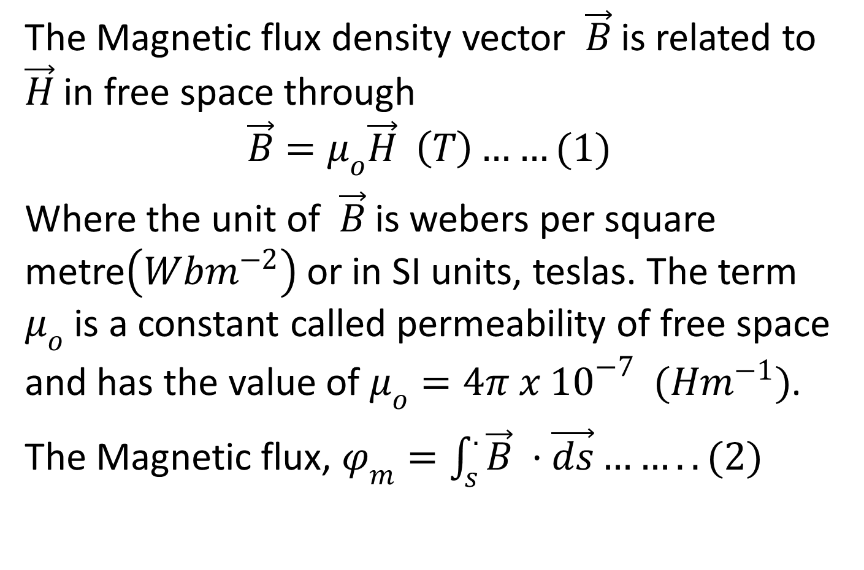
Magnetic Flux Density Vector
The Magnetic flux density vector $\vec{B}$ is related to $\vec{H}$ in free space through
$$\vec{B}=μ_{o}\vec{H} \left(T\right)……(1)$$
Where the unit of $\vec{B}$ is webers per square metre$\left(Wbm^{−2}\right)$ or in SI units, teslas. The term $μ_{o}$ is a constant called permeability of free space and has the value of $μ_{o}=4π x {10}^{−7} (Hm^{−1})$.
The Magnetic flux, $φ_{m}=\int_{s}^{.}{\vec{B} ·\vec{ds}……..(2)}$

Slide 19
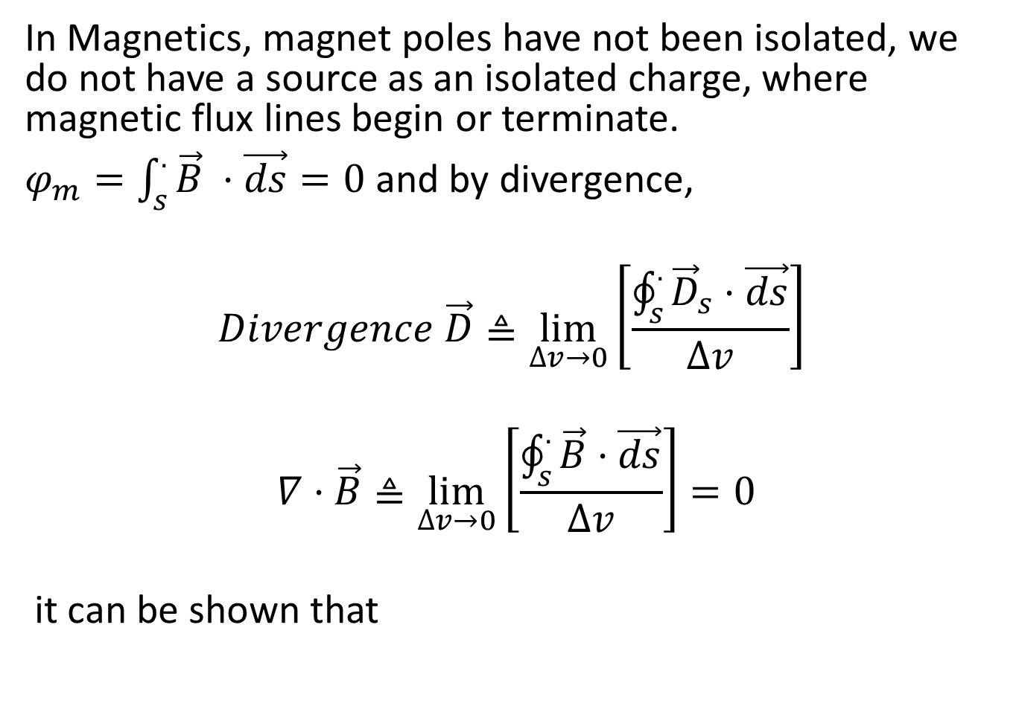
In Magnetics, magnet poles have not been isolated, we do not have a source as an isolated charge, where magnetic flux lines begin or terminate.
$φ_{m}=\int_{s}^{.}{\vec{B} ·\vec{ds}=0}$ and by divergence,
$$Divergence \vec{D}≜\lim_{∆v→0}\left[\frac{\oint_{s}^{.}{{\vec{D}}_{s}·\vec{ds}}}{∆v}\right]$$
$$∇·\vec{B}≜\lim_{∆v→0}\left[\frac{\oint_{s}^{.}{\vec{B}·\vec{ds}}}{∆v}\right]=0$$
it can be shown that

Slide 20

$$∇·\vec{B}=0 \left(Tm^{−1}\right)…..(3)$$
Equation (3) is Maxwell’s fourth equation for static fields,

Slide 21
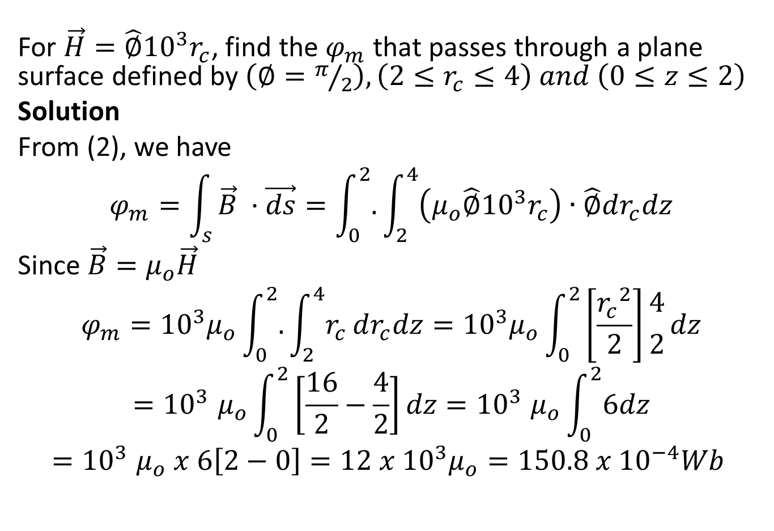
Example
For $\vec{H}=\hat{∅}{10}^{3}r_{c}$, find the $φ_{m}$ that passes through a plane surface defined by $\left(∅=π/2\right),\left(2≤r_{c}≤4\right) and \left(0≤z≤2\right)$
Solution
From (2), we have
$$φ_{m}=\int_{s}{\vec{B} ·\vec{ds}=\int_{0}^{2}{.}\int_{2}^{4}{\left(μ_{o}\hat{∅}{10}^{3}r_{c}\right)∙\hat{∅}dr_{c}dz}}$$
Since $\vec{B}=μ_{o}\vec{H}$
$$φ_{m}={10}^{3}μ_{o}\int_{0}^{2}{.}\int_{2}^{4}{r_{c}}dr_{c}dz={10}^{3}μ_{o}\int_{0}^{2}{\left[\frac{{r_{c}}^{2}}{2}\right]{4 \atop 2}dz}$$
$${=10}^{3}μ_{o}\int_{0}^{2}{\left[\frac{16}{2}−\frac{4}{2}\right]dz}{=10}^{3}μ_{o}\int_{0}^{2}{6dz}$$
$${=10}^{3}μ_{o} x 6\left[2−0\right]=12 x {10}^{3}μ_{o}=150.8 x {10}^{−4}Wb$$

Slide 22
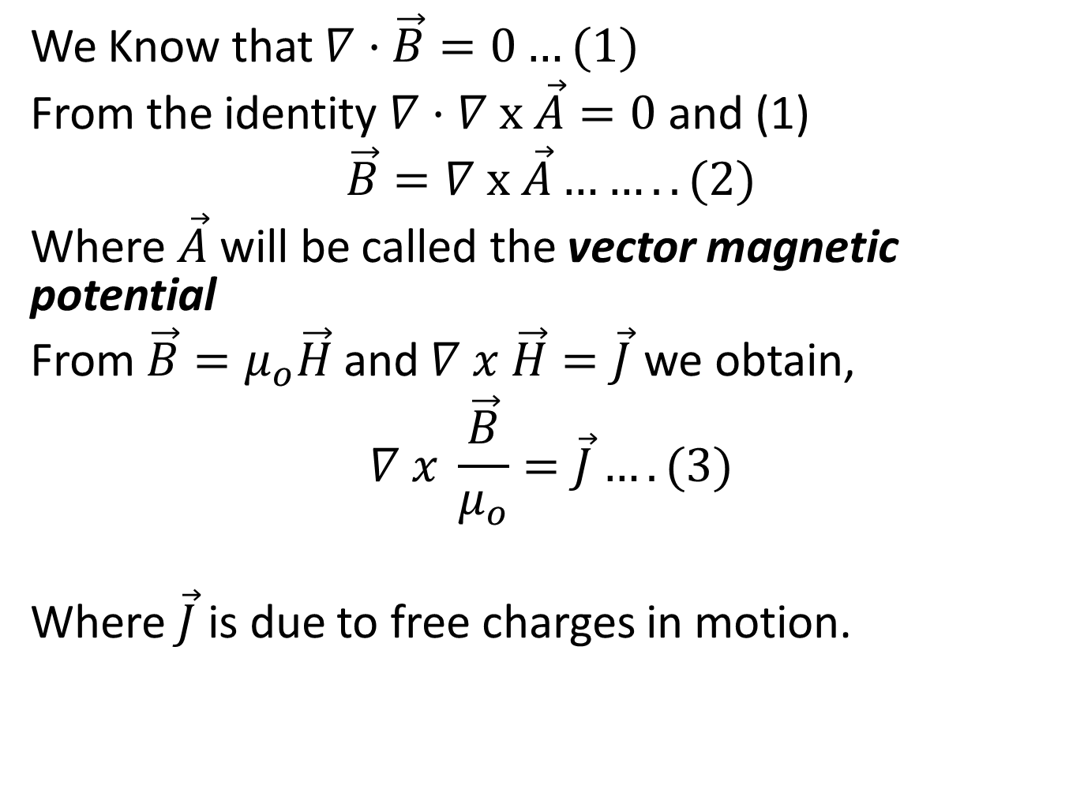
Vector Magnetic Potential
We Know that $∇·\vec{B}=0…(1)$
From the identity $∇·∇ x \vec{A}=0$ and (1)
$$\vec{B}=∇ x \vec{A}……..(2)$$
Where $\vec{A}$ will be called the vector magnetic potential
From $\vec{B}=μ_{o}\vec{H}$ and $∇ x \vec{H}=\vec{J}$ we obtain,
$$∇ x \frac{\vec{B}}{μ_{o}}=\vec{J}….(3)$$
Where $\vec{J}$ is due to free charges in motion.

Slide 23
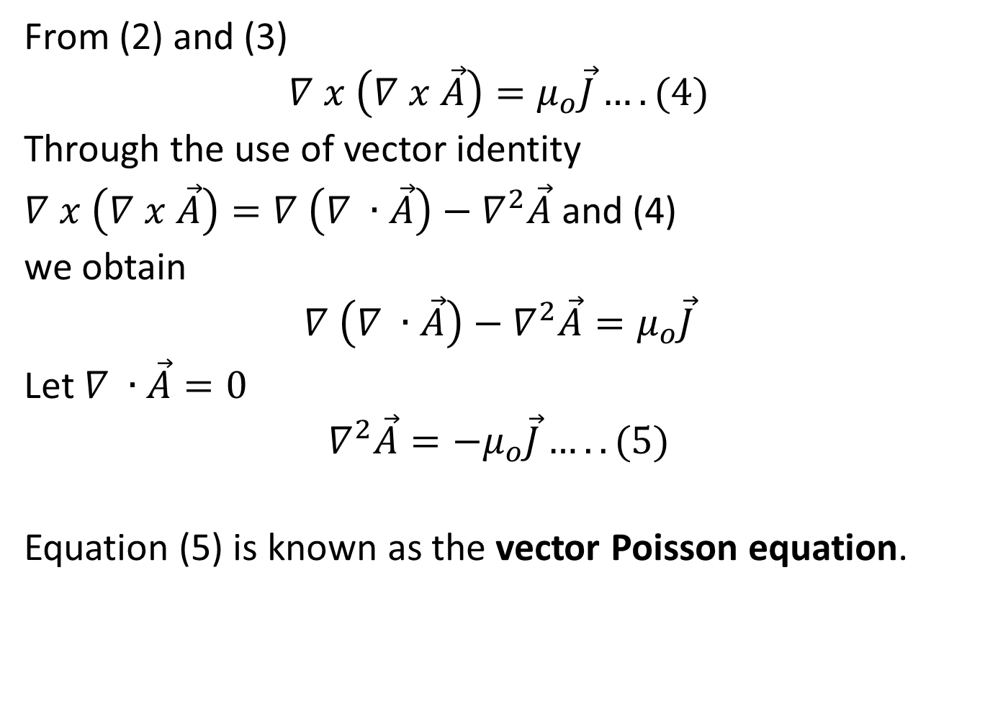
From (2) and (3)
$$∇ x \left(∇ x \vec{A}\right)=μ_{o}\vec{J}….(4)$$
Through the use of vector identity
$∇ x \left(∇ x \vec{A}\right)=∇ \left(∇ ∙\vec{A}\right)−∇^{2}\vec{A}$ and (4)
we obtain
$$∇ \left(∇ ∙\vec{A}\right)−∇^{2}\vec{A}=μ_{o}\vec{J}$$
Let $∇ ∙\vec{A}=0$
$$∇^{2}\vec{A}=−μ_{o}\vec{J}…..(5)$$
Equation (5) is known as the vector Poisson equation.

Slide 24
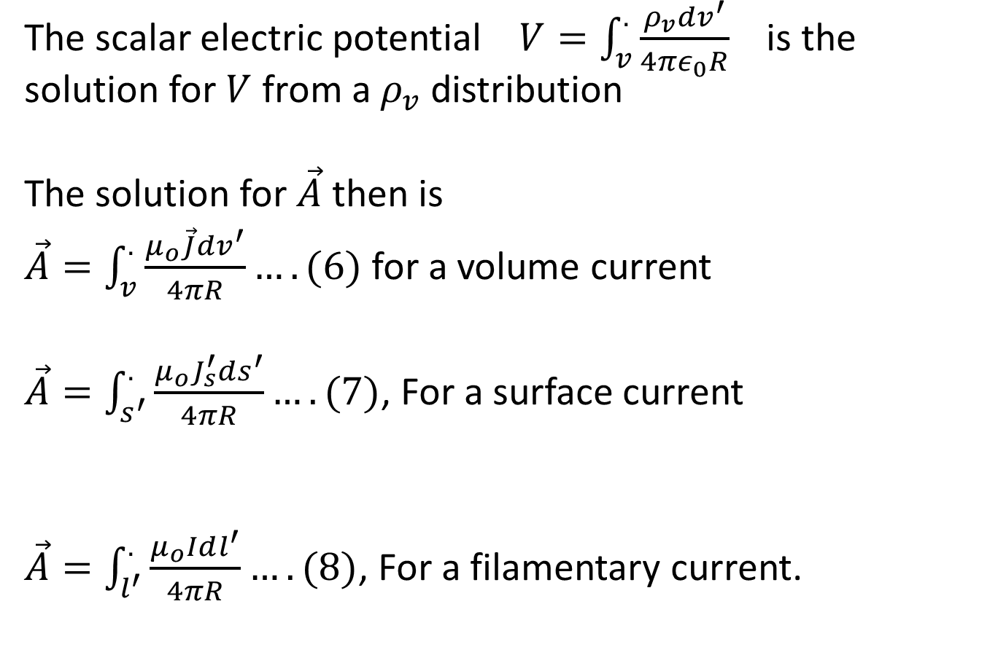
The scalar electric potential $V=\int_{v}^{.}{\frac{ρ_{v}dv^{′}}{4πε_{0}R}}$ is the solution for $V$ from a $ρ_{v}$ distribution
The solution for $\vec{A}$ then is
$\vec{A}=\int_{v}^{.}{\frac{μ_{o}\vec{J}dv^{′}}{4πR}}….(6)$ for a volume current
$\vec{A}=\int_{s^{′}}^{.}{\frac{μ_{o}J_{s}^{′}ds^{′}}{4πR}….(7)}$, For a surface current
$\vec{A}=\int_{l^{′}}^{.}{\frac{μ_{o}Idl^{′}}{4πR}….(8)}$, For a filamentary current.

